Slide 1
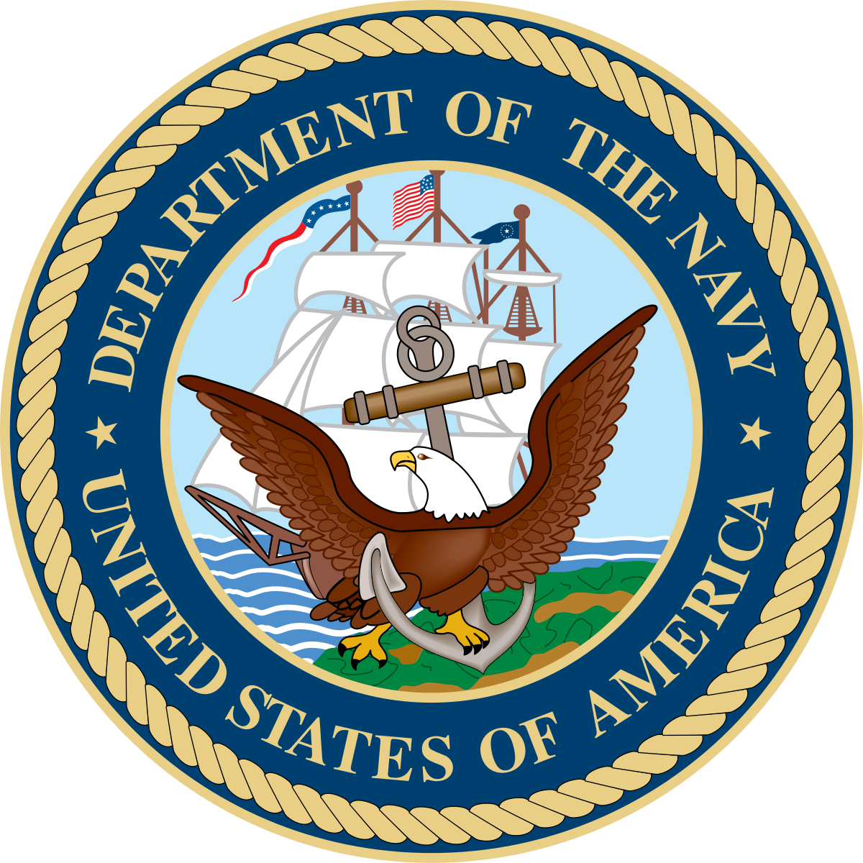
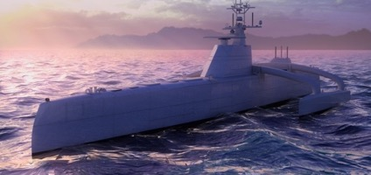
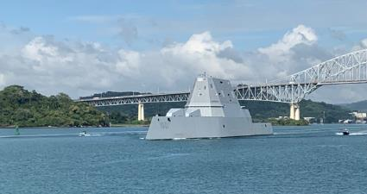
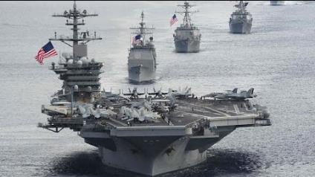
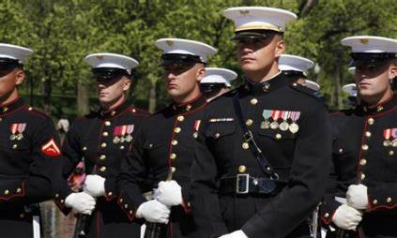
2022 DSP 70th Anniversary Conference
Department of the Navy (DON)
Dr. Brett Seidle, DASN (RDT&E) Standardization Executive
01-03 AUG 2022
Distribution Statement A

Slide 2
DON Standardization Topics
DON Standardization Policy
Challenges We Face Today
DSP Standardization Awards
Cross-SYSCOM Efforts
DON Way Forward

Slide 3
DON Standards Policy
SECNAVINST 4120.24 provides Naval policy and procedures for Defense Standardization and standards created by technical authorities, not just DSP standards.
Standardization allows PMs to improve the efficiency and effectiveness of delivering sustainable products to the war fighter.
The goal of standardization efforts is to improve relevance, safety, currency, total ownership cost, and commonality.
DASN RDT&E is the DON Standardization Executive (Brett Seidle) and appoints the DON Standardization Officer (Chris Paquette since 2010, replaced by Chris Dowd in July).
SYSCOM CHENGs ensure proper technical authority ownership of standards and compliance with standards policies.

Slide 4
Challenges We Face Today
How do we publish and use standards?
Enabling new technology with standards?
Configuration management of digital data & metadata tagging?
Data management of large data sets?
Data protection and intellectual property rights?
Upgrade data capabilities within ASSIST?
How to effectively fund access to industry standards?
Winning the Global power competition?

Slide 5
DSP Standardization Awards
FY21 DoD 34th Annual Defense Standardization Program (DSP) Award Winner for DON:
Naval MIL-STD-889 Rev. D, Galvanic Compatibility of Electrically Conductive Materials – Naval Air Systems Command (Lakehurst)
Winning team members were:
Frank Magnifico,
Rade Savija,
Rachel Cusic,
Victor Rodriguez-Santiago,
Anna Safigan, and
Nahid Ilyas.

Slide 6
Cross-SYSCOM Efforts
The Navy has several working groups that coordinate standardization efforts across SYSCOMs & DoD. Four successful teams will be presenting these coordinated portfolios at this workshop:
Human Systems Integration (HSI) Standards Portfolio (Jeff Markiewicz)
Configuration Management (CM) Standards Portfolio, (Dan Christensen)
Unmanned Maritime Autonomy Architecture (UMAA) Standards Portfolio, (Dennis Patrone)
Additive Manufacturing (AM) Standards Portfolio, (Justin Rettaliata / Susan Hovanec)
Other coordinated efforts include:
DID Approval Authority (NAVSUP)
DON DISA Representative (NAVWAR)
International Standardization POC (NWDC / USMC)
OSD Lead Efforts such as Digital Engineering & MOSA (DASN / SYSCOMs)

Slide 7
DON Way Forward
Ensure DON is organized with relevant policy & standards to support the warfighter.
Evaluate and fill gaps within DON, and ensure our portfolio is up-to-date.
Transfer government standards to industry standards when an effective business case exists.
Create solutions to improve DON participation within industry committee work, and improve DON accessibility to industry standards.

Slide 8
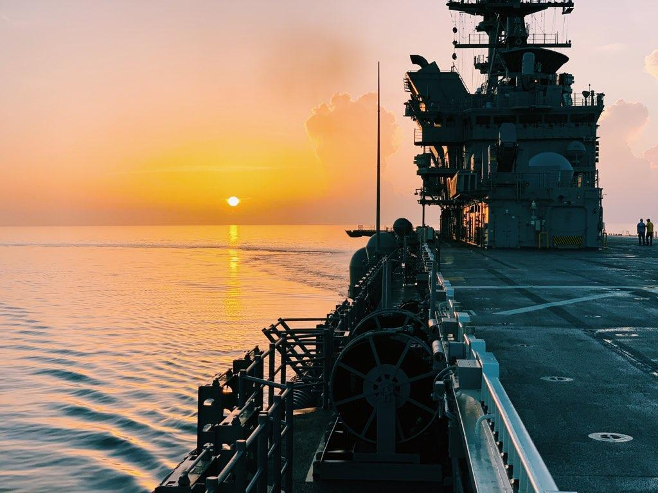
Questions
Distribution Statement A
7

